Slide 1




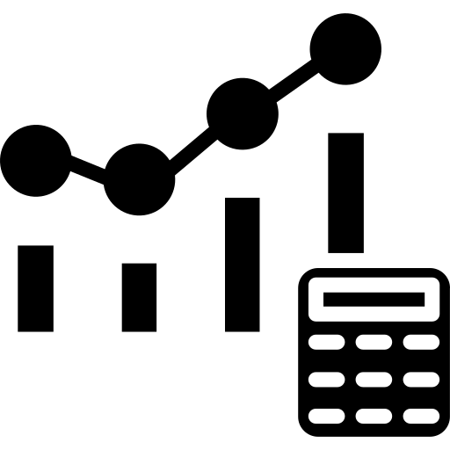

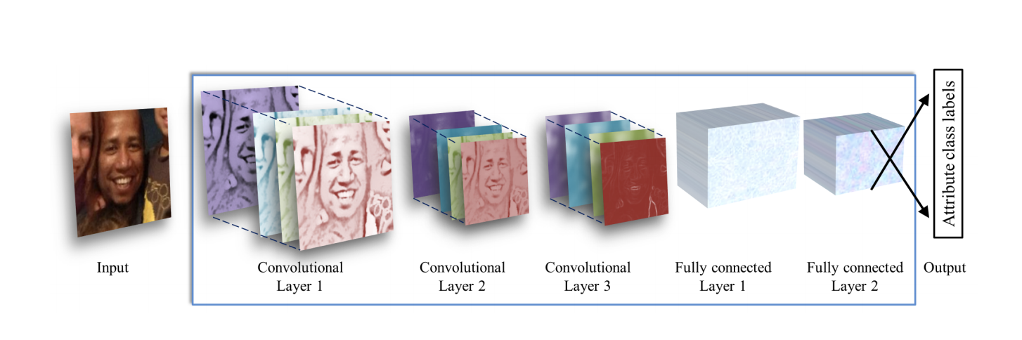
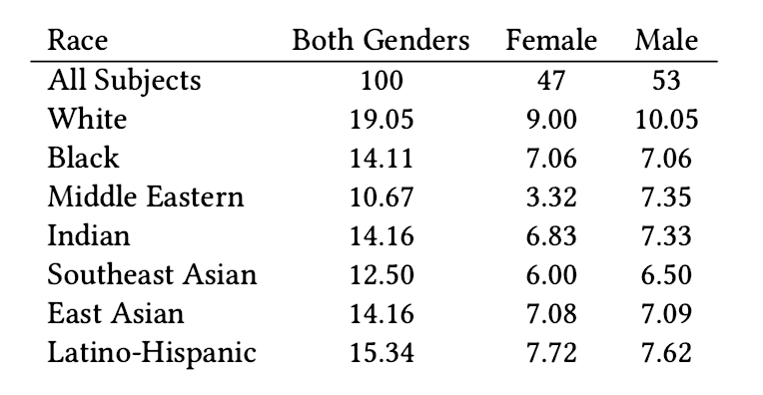
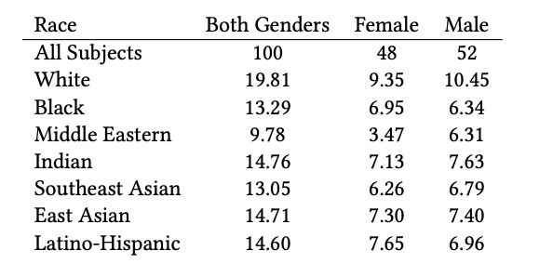
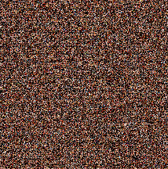
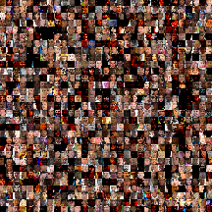

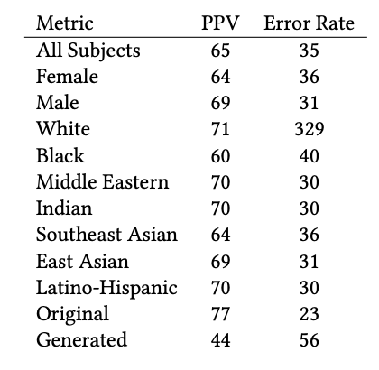
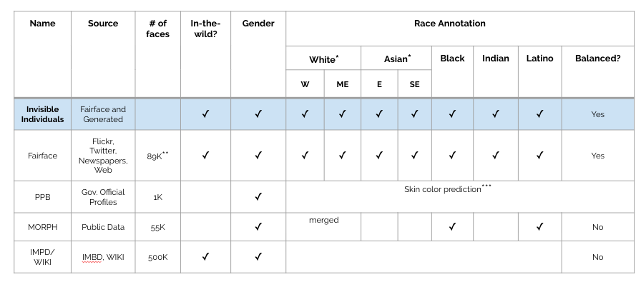
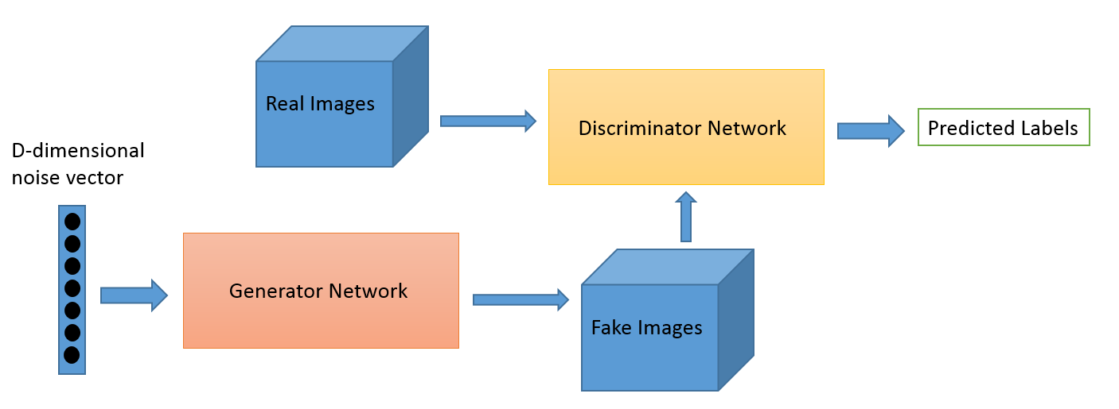
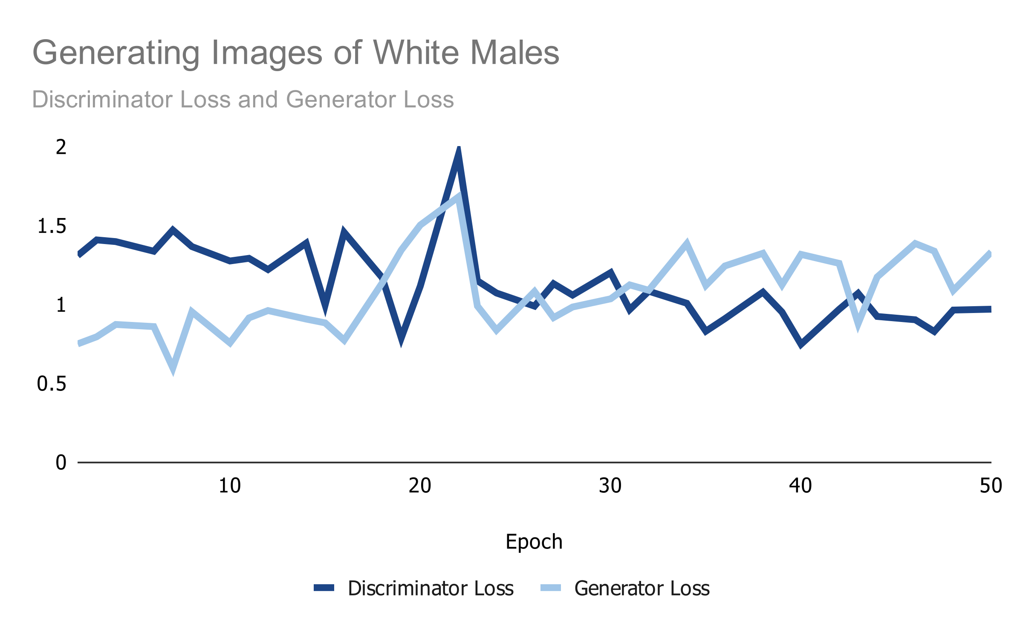
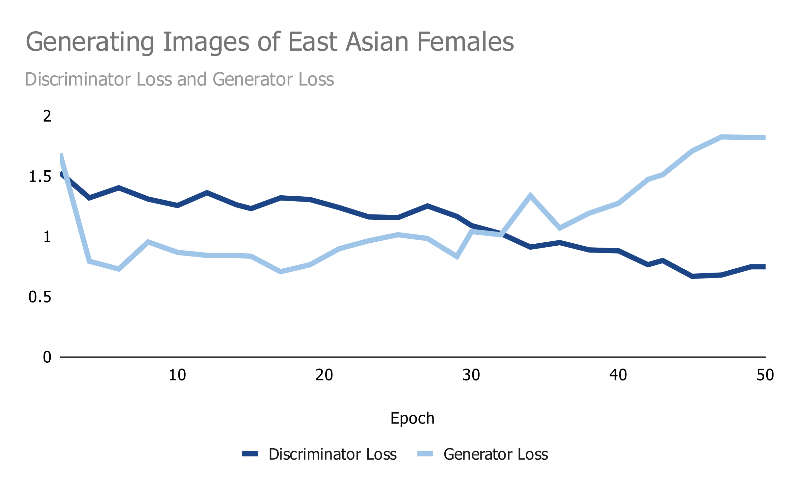
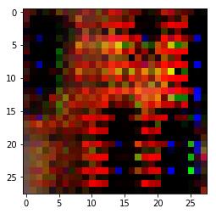
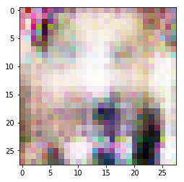
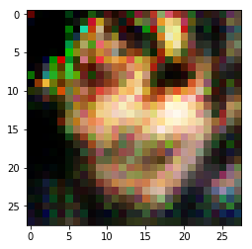
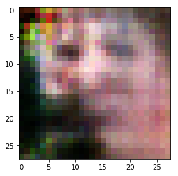
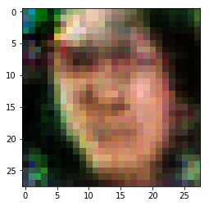
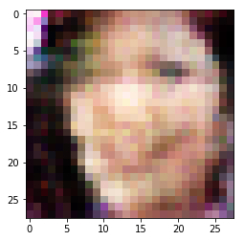
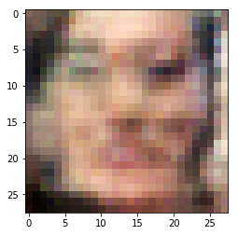
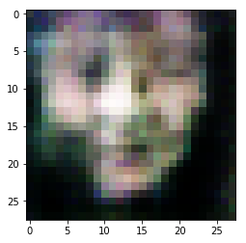
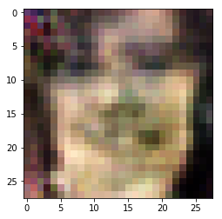



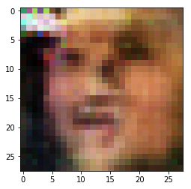
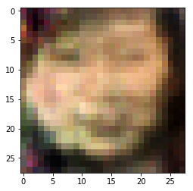
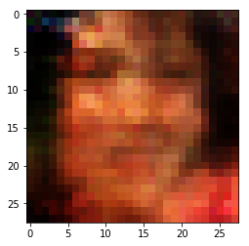
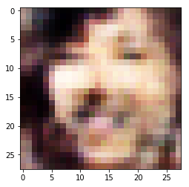
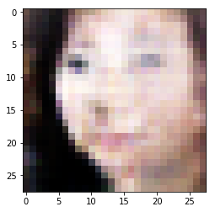
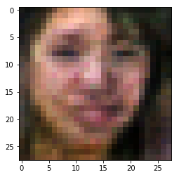
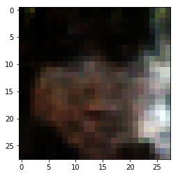
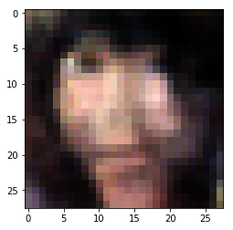
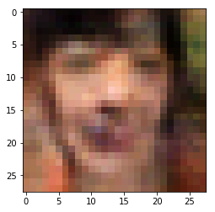
INVISIBLE INDIVIDUALS
Identifying Limitations and Improving Facial Recognition of Marginalized Identities
Mira Chugh ’20 & Nadani Dixon ‘20
CS 701, Fall 2019, Advised by Philip Caplan - Department of Computer Science, Middlebury College
MOTIVATION
Male
Positive Predictive Value (PPV) = True Positive/All Positive
Most data sets used to train facial verification and classification software are overwhelmingly made up of images of lighter-skinned individuals.
As a result, these models have been proven to discriminate on classes like race and gender and have limited accuracy on classifying and recognizing images of darker-skinned subjects.
These technologies have become widely available and accessible to the general public. Despite the excitement surrounding facial recognition and the significant advancements made in the field as well as with this increased access and adoption, the lack of diversity of data sets used to train these models has become less of a question about inclusivity and more about the protection of lives.
Algorithmic bias in facial recognition is life or death.
Error Rate + 1 - PPV
Invisible Individuals Dataset
Pretrained Gender Classifier - ConvNet
Female
Evaluation
Gender Predictions
ConvNet Architecture
lightweight, open source algorithm that learns from unconstrained images focused on overfitting
87% Reported Accuracy
SCOPE & GOALS
RESULTS
In an attempt to identify limitations and improve facial recognition of marginalized identities, our research consisted of two parts:
Composition of FairFace Dataset
Composition of Invisible Individuals Dataset
Creating a diverse and unconstrained (in relation to pose, illumination and expression) dataset comprised of both synthesized and photographed images
Identify limitations of existing tools in classifying gender by auditing a lightweight, open source gender classification algorithm.
Are these facial recognition algorithms really as accurate as the researchers who developed them say they are?
Can these algorithms consistently maintain its performance and accurately classify the genders of individuals across racial groups?
96853 images
139021 images – 30.33 % Generated
METHODS
Data Processing
Image Generation
Split Data
Synthesized Images
Synthesized & Photographed Images
FairFace Dataset
Male
Female
Black, East Asian, Indian, Latino-Hispanic, Middle Eastern, South East Asian, White
Invisible Individuals Dataset
1. Cropped, Normalized, Split Dataset
Cropped: removed pixels not in faces
Normalized: scaled images to 28x28
Split FairFace into race and gender subgroups
2. Synthesized Images with a General Adversarial Network (GAN)
Deep neural net architecture
Consists of 2 oppositional networks: generator and discriminator
Learns to mimic the distribution of data
All 139021 Images in Invisible Individuals
Sample of 250 Images from Invisible Individuals Dataset
Performance of ConvNet in Classifying Gender on 13% Invisible Individuals Data
Why did ConvNet perform worse? It was trained on MORPH and IMPD/WIKI
Statistics of Face Attribute Datasets
3. Tuned Hyperparameters:
Alpha: started at .2, changed with learning rate of .001
Beta 1: .5
Batch Size: 64
Epochs:30
GAN Architecture
* Our dataset and Fairface define East (E) Asian, Southeast (SE) Asian, Middle Eastern (ME), Western (W) White.
** The Fairface paper claimed their dataset had 108K images, but we found the actual dataset released had 89K.
*** PPB doesn’t provide race annotations, but skin color annotated as a proxy to race.
MAJOR CONTRIBUTIONS
Generating Images of White Males
Discriminator Loss & Generating Loss
Generating Images of East Asian Females
Discriminator Loss & Generating Loss
Created the first large balanced unconstrained dataset that has both generated and ‘in the wild’ photos
Diversity of images:
Includes Latino/Hispanic and Middle Eastern subjects
Differentiates between Asian and Southeast Asian
Testing models on our data could expose gender and racial biases
FUTURE WORK
Regenerate images (especially for female black, male black, male middle eastern)
Generate better quality images
Audit/train/test more models using our dataset, compare performances
Train large facial recognition systems on Invisible Individuals Data
Differentiate between biological sex and gender presentation in images and classification
White males subset of FairFace through GAN, with epochs set to 50. Both Generator and Discriminator Loss seem to stabilize after 30 epochs. Chosen because it was the highest possible number given time constraints (50 epochs took more than 12 hours)
Reduced number of epochs given time constraints. Ran East Asian subset of FairFace through GAN. Generator and Discriminator Loss seemed to increase after 30 epochs.
Increase number of race categories to include other race identities
Sample Sequence of Generated Images
(East Asian Females)
ALGORITHMS & TECHNOLOGIES
Deep Convolutional General Adversarial Network implemented with Tensorflow
Convolutional Neural Net (Tuned for Age and Gender Classification) Implemented in Tensorflow
REFERENCES
Joy Buolamwini and Timnit Gebru. 2018. Gender shades: Intersectional accuracy disparities in commercial gender classification. InConference on fairness, accountability and transparency. 77–91
Kimmo Kärkkäinen and Jungseock Joo. 2019. FairFace: Face Attribute Dataset for Balanced Race, Gender, and Age. arXiv preprint arXiv:1908.04913 (2019).
Gil Levi and Tal Hassner. 2015. Age and Gender Classification Using Convolutional Neural Networks. In IEEE Conf. on Computer Vision and Pattern Recognition (CVPR)
workshops. https://osnathassner.github.io/talhassner/projects/cnn_agegender
Dominic Monn. 2017. Deep Convolutional Generative Adversarial Networks with TensorFlow. https://github.com/dmonn/dcgan-oreilly
Epoch 2
Epoch 50

